Slide 1
SMARTFLOW SUITE
Enterprise Contract Management Dashboard
By: Rakshita Gupta

Slide 2
PROBLEM STATEMENT
Organizations often struggle with manual contract handling, scattered records, missed expiry dates, and lack of centralized monitoring systems.
Traditional contract management processes are time-consuming, difficult to track, and prone to errors. Businesses require a digital platform that can securely manage agreements, monitor contract status, visualize analytics, and simplify document handling through an interactive dashboard.

Slide 3
OBJECTIVES
• To develop a centralized contract management platform
• To simplify agreement tracking and monitoring
• To provide contract analytics visualization
• To implement secure authentication and access control
• To support PDF and document uploads
• To create a responsive and modern enterprise dashboard

Slide 4
FEATURES
• Secure Login Authentication
• Role-Based Access System
• Add / Delete / Manage Agreements
• Contract Status Tracking
• PDF Contract Upload Support
• Analytics Dashboard
• Revenue Visualization Charts
• Search Functionality
• Expiry Alerts & Notifications
• Export Report Feature
• Dark / Light Theme Toggle
• Fully Responsive UI

Slide 5
TECH STACK
FRONTEND
• HTML5
• CSS3
• Bootstrap 5
• JavaScript
BACKEND
• Python
• Flask Framework
DATABASE
• SQLite3
LIBRARIES & TOOLS
• Chart.js
• Git & GitHub
• Render Deployment

Slide 6



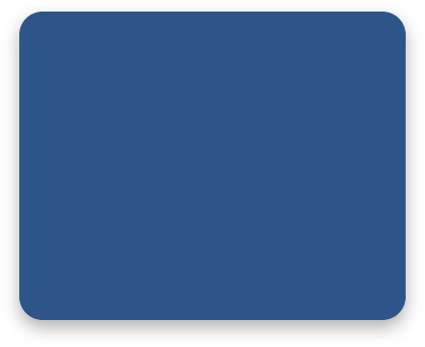
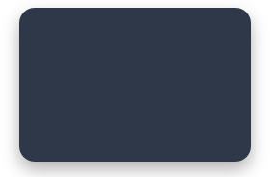
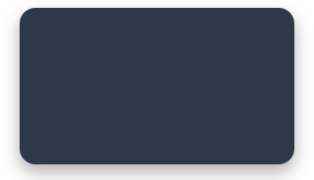
SYSTEM ARCHITECTURE
DASHBOARD ANALYTICS
FLASK APP
Backend Core
USER
LOGIN AUTH
RBAC System
FILE MANAGEMENT
REPORTS & VISUALS
SQLITE DB
Persistent Storage

Slide 7
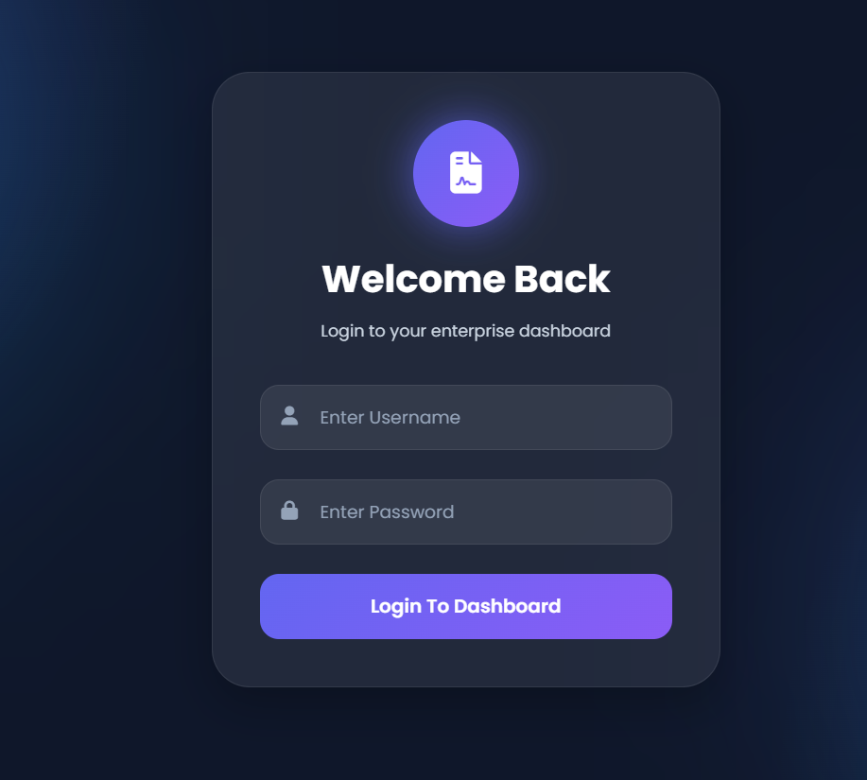
SCREENSHOTS
Login Page

Slide 8
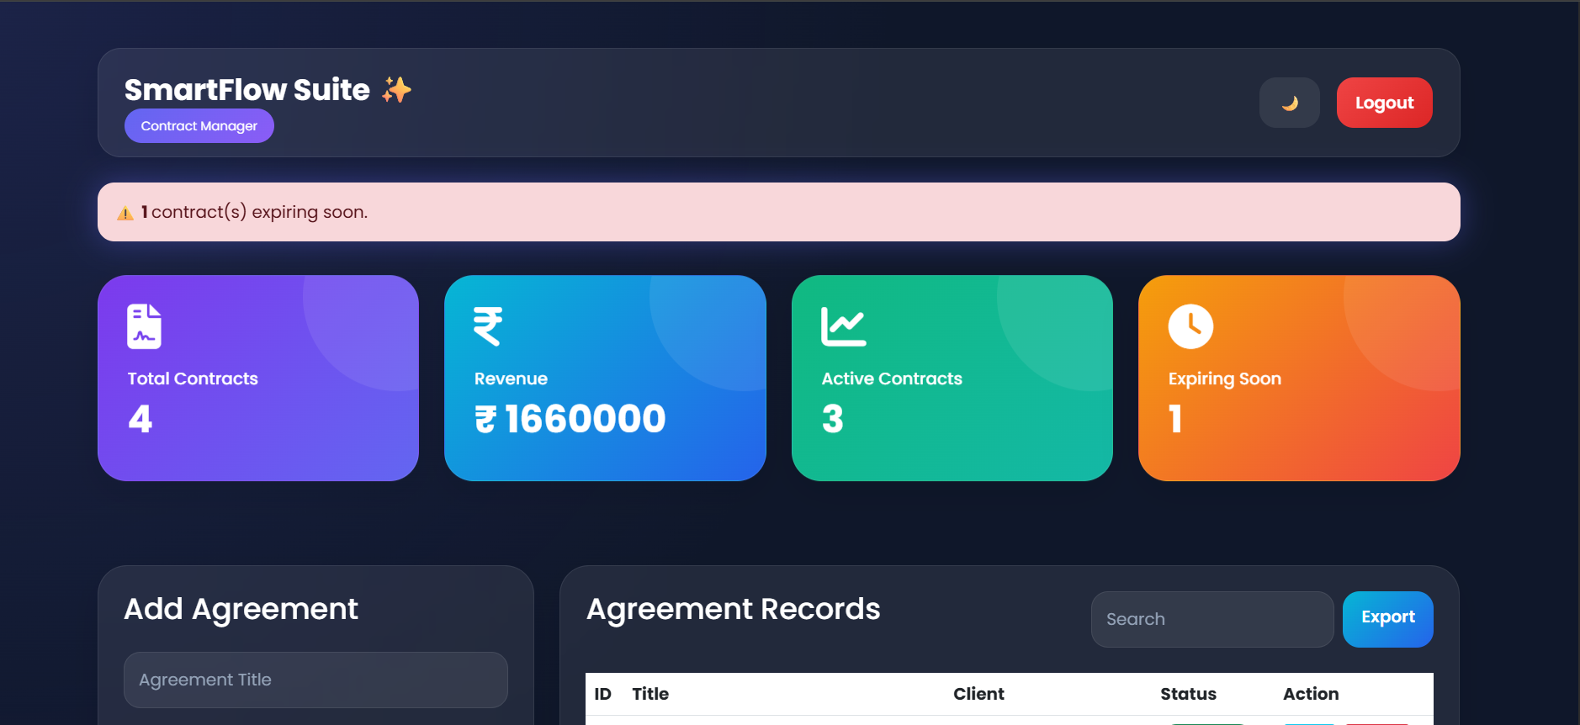
Dashboard Interface
.

Slide 9
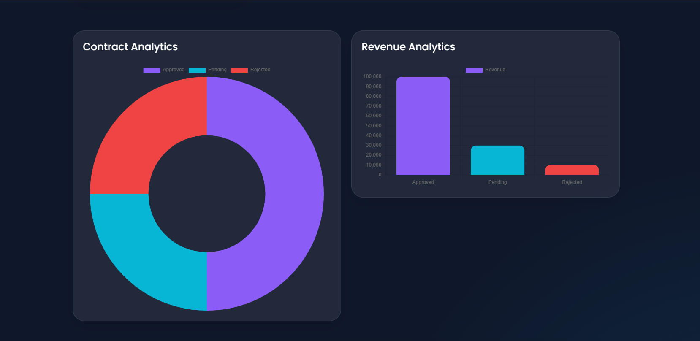
Analytics Charts

Slide 10
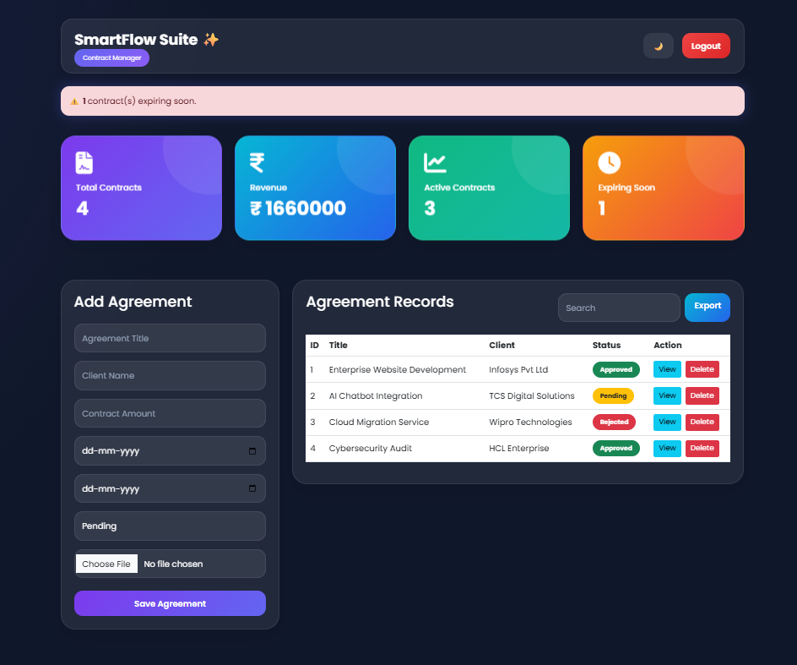
Dark Mode UI

Slide 11
FUTURE SCOPE
• AI-Based Contract Insights
• Email Notification Integration
• Digital Signature Support
• PostgreSQL Database Integration
• REST API Development
• Cloud Storage Integration
• Multi-User Collaboration
• Real-Time Notifications
• Advanced Role-Based Permissions

Slide 12
CONCLUSION
SmartFlow Suite successfully provides a centralized and interactive enterprise contract management platform.
The system simplifies agreement handling, improves monitoring efficiency, enhances visualization through analytics dashboards, and delivers a modern responsive user experience.
The project demonstrates practical implementation of full-stack web development concepts using Flask, SQLite, Bootstrap, and Chart.js.

